Slide 1
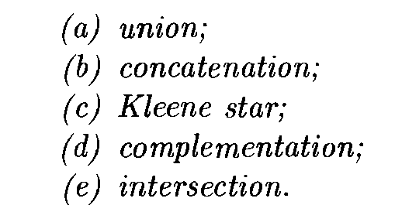

Slide 2
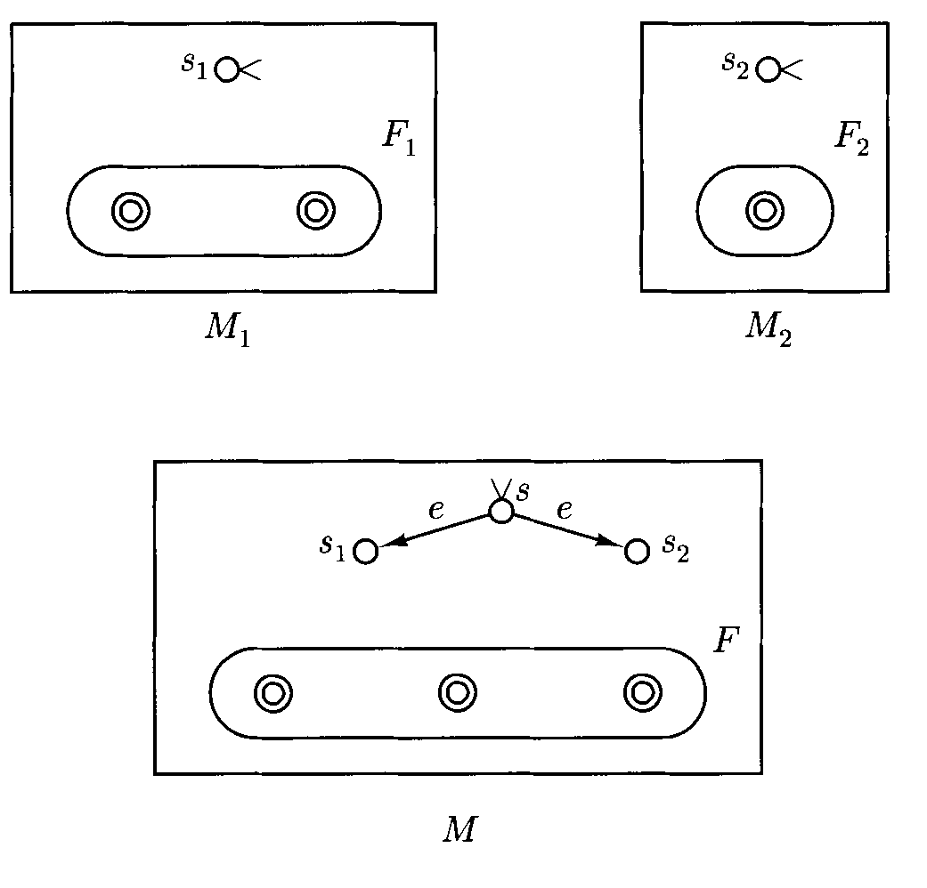
(a) Union

Slide 3

Formal Description of M_{union}

Slide 4
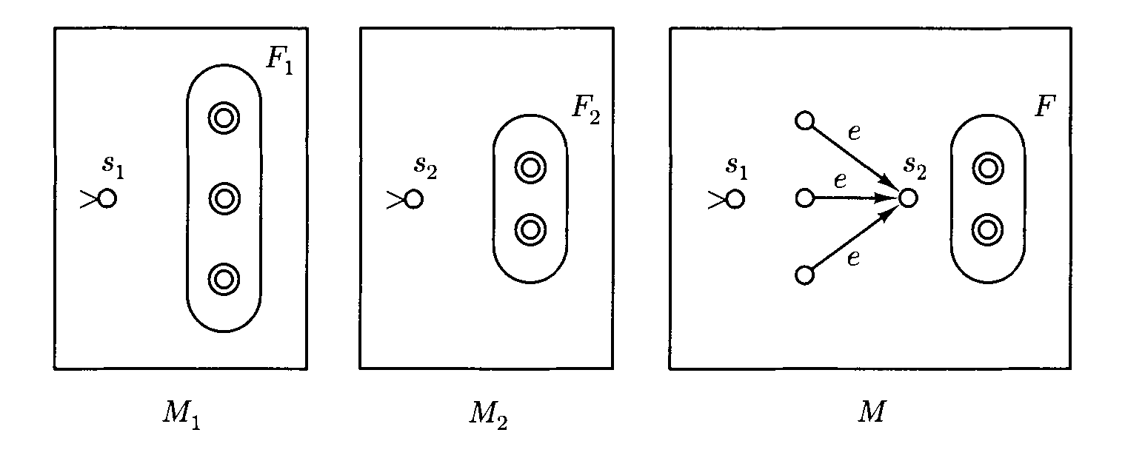
(b) Concatenation

Slide 5
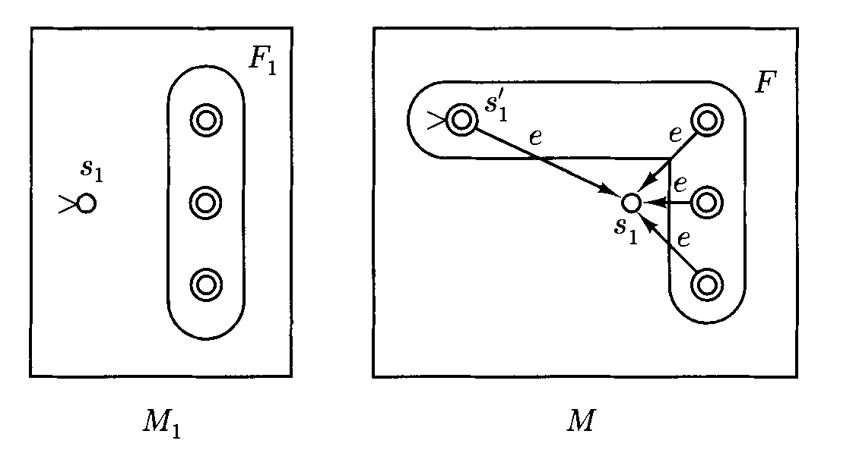
(c ) Kleene Star

Slide 6


Slide 7
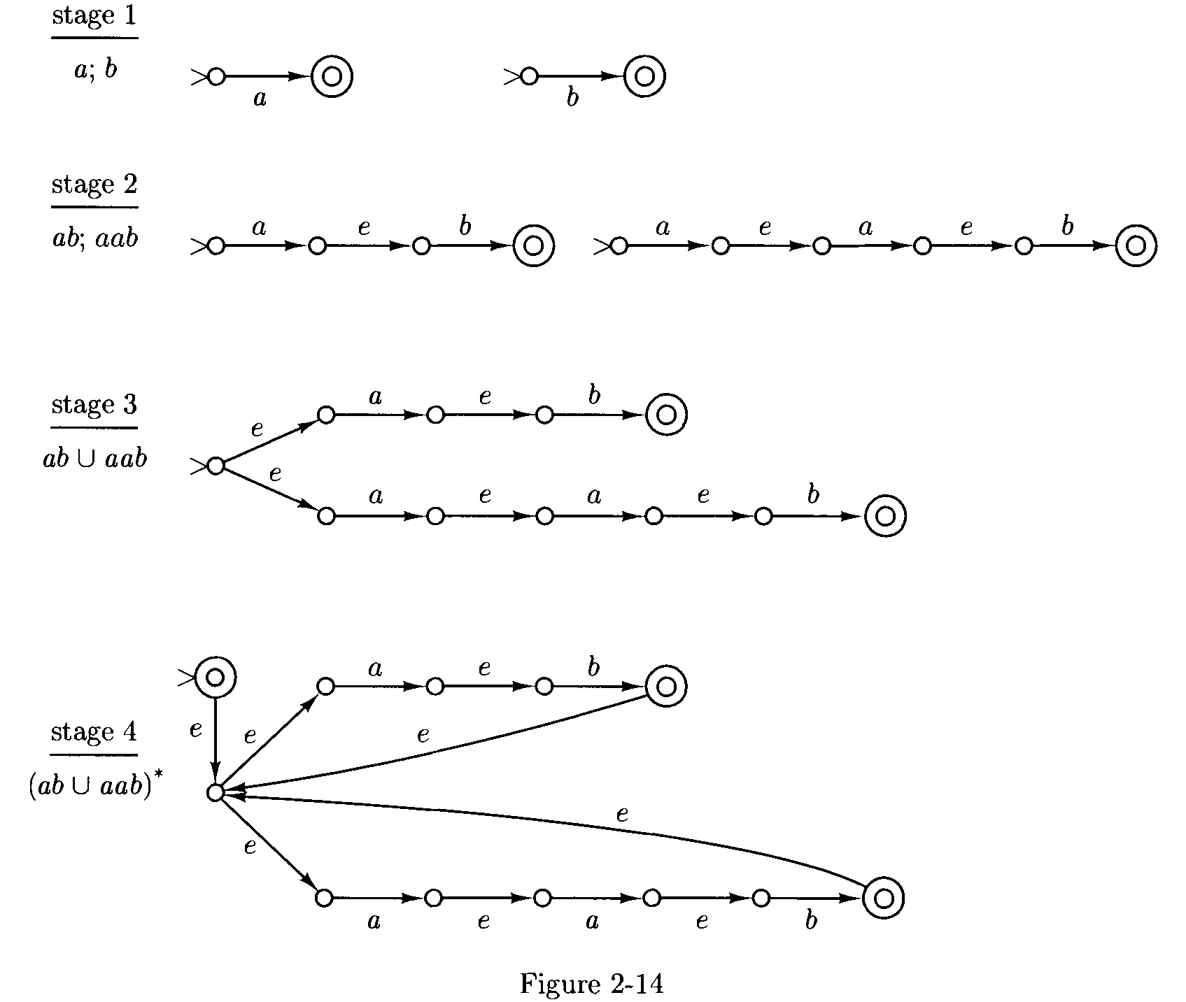
Ex: Design a FSA for L= (ab U aab)*

Slide 8
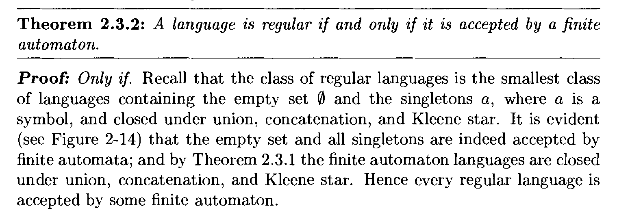

Slide 9



Slide 10
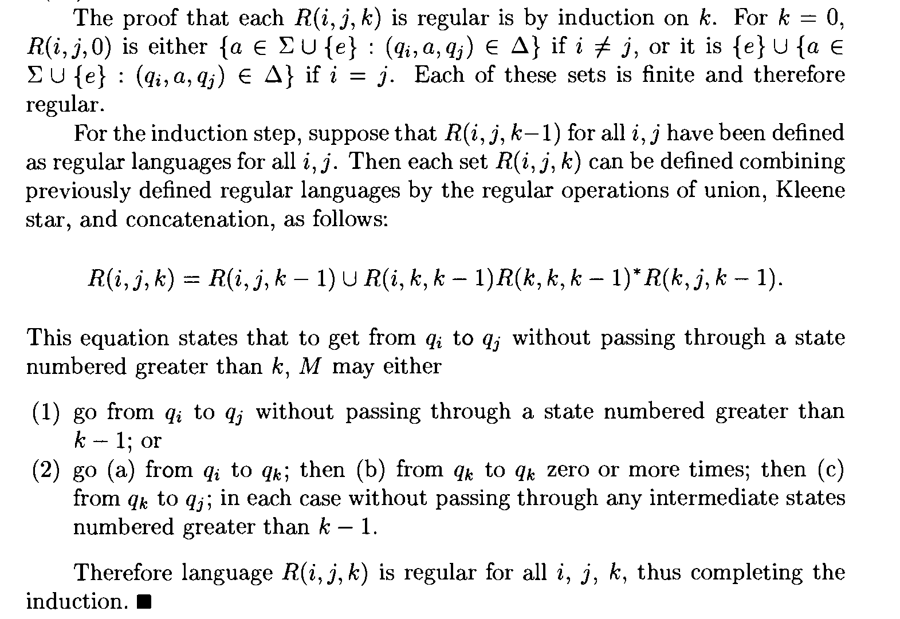

Slide 11



Slide 12


Slide 13


Slide 14


Slide 15
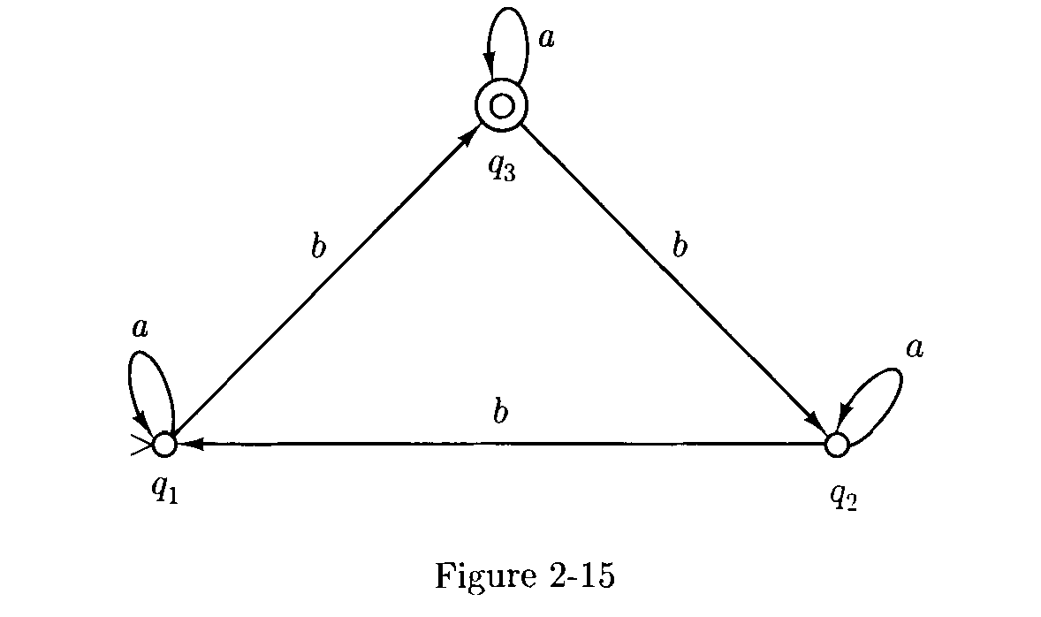

Slide 16
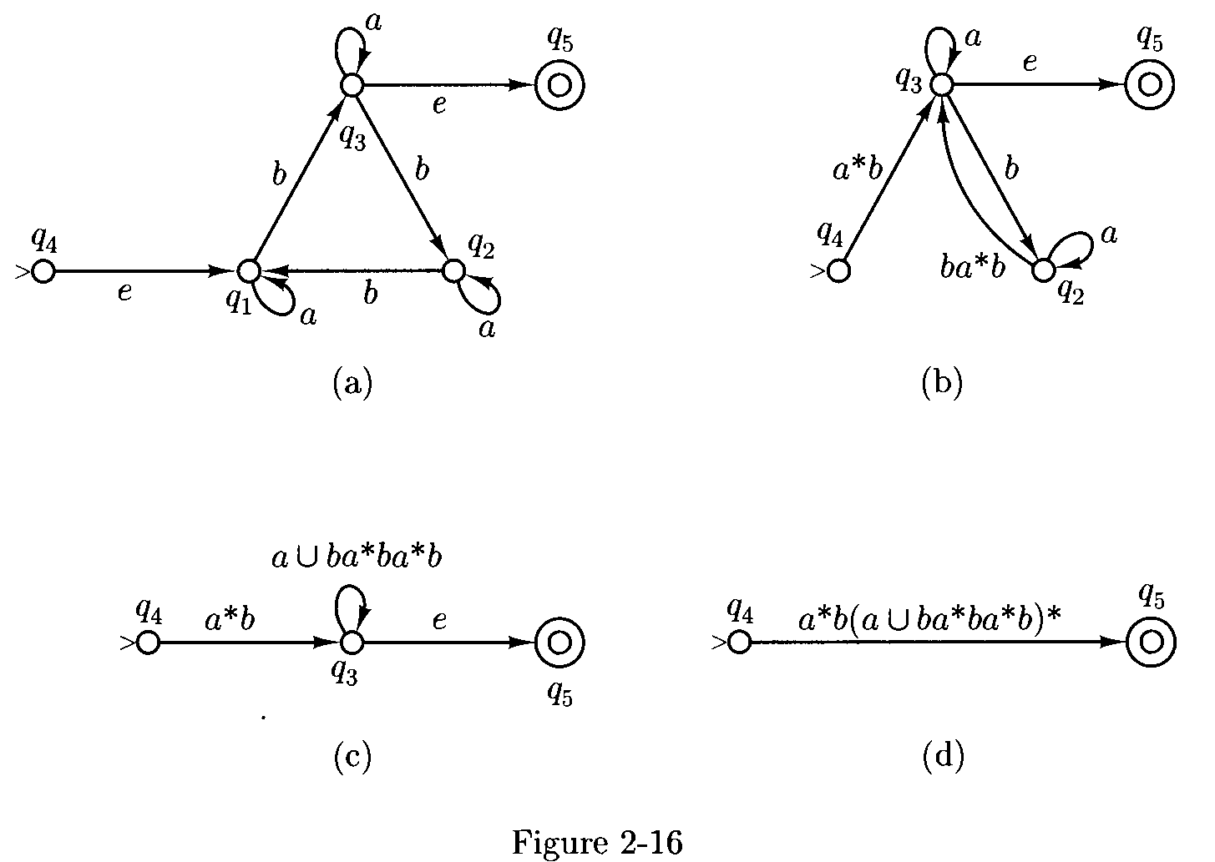

Slide 17
